Slide 1

Python Advanced

Slide 2
Warning!
For Python Advanced, it is mandatory to have followed the course Python Fundamentals.
Python Fundamentals is an entry requirement for Python Advanced.

Slide 3
Program
File handling
Exception handling
Object oriented programming
Classes, methodes and attributes
Magic methodes
Inheritance
Python Standard Library
Python Package Index
Python for Data Science beginnings

Slide 4
Recap
Python prompt
Executing a Python module
Variables
Operators
Built-in functions
Strings
Conditional statements
Loop statements
Datastructures – Lists, Sets, Dicts
Comprehension
Functions – definition, arguments, return
Generators

Slide 5
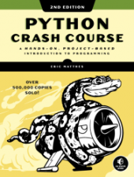
Book
Part I: Basics
Getting started
Variables and Simple Data Types
Introducing Lists
Working with Lists
If Statements
Dictionaries
User input and While Loops
Functions
Classes
Files and Exceptions
Testing Your Code
Part II: Projects
Project 1: Alien Invasion
Project 2: Data Visualization
Project 3: Web Applications
Resources:
https://ehmatthes.github.io/pcc_2e/regular_index/

Slide 6
Read from a file
The open() built-in function is used to access files
A file can be opened in different modes: read, write or append
The keyword with specifies a context manager
read
readline
readlines
write
seek
close
keyword = 'xxx'
filename = 'data.txt'
with open(filename) as f:
for line in f:
line = line.strip()
if keyword in line:
print(line)

Slide 7
Write to a file
Modes: r, w, a, b
filename = 'data.txt'
with open(filename, 'w') as f:
f.write('ID, A, B\n’)
f.write('line 1, 2.0, 10.0\n’)
f.write('line 2, 2.1, 10.0\n’)
f.write('line 3, 2.1, 10.0\n')

Slide 8
Writing to and reading from a file
Exercise 1.1
First create a file with open and write mode
Write a header line to the file. E.g. 'ID,var1,var2,var3'
Write a couple of lines to the file. E.g. '1001, 5, 1.23, "Y"'
Then create a new program
Open the file in read mode
Read the header and split into a list of headers
For each line split the line into values
Create a dictionary with the header and the values using zip()
Filter on one off the fields and print the lines

Slide 9
Read a CSV file
Exercise 1.2
Filter lines from a CSV file
Tips:
Get the ca-500.csv file
Open the file within a context manager with the keyword with
Read the first line. The header.
In a for loop through all lines.
For each line strip the newline character from the end with strip
Split the line into a list of values with split
Only select lines with city 'Montreal'
Print firstname, lastname, city and email

Slide 10
Solution Read a CSV file
filename = "ca-500.csv"
with open(filename) as f:
headers = f.readline().rstrip("\n").split(';')
for line in f:
columns = line.rstrip("\n").split(';')
d = dict(zip(headers, columns))
if d['city'] in ('Montreal', 'Vancouver'):
print("{:10} {:15} {:20} {:30}".format(
d['first_name'],
d['last_name'],
d['city'],
d['email']))

Slide 11
Reading a CSV file with csv
csv module from Python Standard Library
import csv
filename = "ca-500.csv"
colnames = ('first_name', 'last_name', 'city', 'email')
with open(filename) as f:
reader = csv.DictReader(f, delimiter=';', quotechar='"')
for d in reader:
if d['city'] in 'Montreal’:
print('{:10}{:20}{:30}{:30}'.format(
*[d[fieldname] for fieldname in colnames]))

Slide 12
Exceptions
StopIteration
SystemExit
StandardError
ArithmeticError
OverflowError
FloatingPointError
ZeroDivisionError
AssertionError
AttributeError
EOFError
ImportError
KeyboardInterrupt
LookupError
IndexError
KeyError
NameError
UnboundLocalError
EnvironmentError
IOError
OSError
SyntaxError
IndentationError
SystemError
SystemExit
TypeError
ValueError
RuntimeError
NotImplementedError
Run-time errors cause the execution of the code to stop.
Run-time errors are called Exceptions
Where are many different types of Exceptions:
Traceback (most recent call last):
File "<input>", line 1, in <module>
ZeroDivisionError: integer division or modulo by zero

Slide 13
Catching Exceptions
Exceptions can be caught by using the try and except keywords.
Different exceptions can be caught by multiple except blocks
A finally and an else block can optionally also be added.
try:
d = 1/0
d = int("one")
except ZeroDivisionError:
print("Cannot divide by zero")
except ValueError:
print("Wrong type")
except:
print("Another type of error occured")

Slide 14
EAFP versus LBYL
EAFP
Easier to ask for forgiveness than permission. This common Python coding style assumes the existence of valid keys or attributes and catches exceptions if the assumption proves false. This clean and fast style is characterized by the presence of many try and except statements. The technique contrasts with the LBYL style common to many other languages such as C.
LBYL
Look before you leap. This coding style explicitly tests for pre-conditions before making calls or lookups. This style contrasts with the EAFP approach and is characterized by the presence of many if statements.
In a multi-threaded environment, the LBYL approach can risk introducing a race condition between “the looking” and “the leaping”. For example, the code, if key in mapping: return mapping[key] can fail if another thread removes key from mapping after the test, but before the lookup. This issue can be solved with locks or by using the EAFP approach.

Slide 15
Throwing an Exception
An exception can also be thrown from the code with the raise keyword.
An built-in Exception can be thrown or a custom user-defined Exception
def calculate_area(width, height):
if width < 0 or height < 0:
raise Exception('Invalid argument')
return width * height
try:
area = calculate_area(10, -2)
except Exception as err:
print(err)

Slide 16
Custom error message
Exercise 1.3
Try to open a (non-existing) file for reading and return a custom error message if the file does not exist.
Tips:
Assign a filename to a variable. E.g. filename = 'a_file_that_does_not_exist.txt'
Add a try statement
Open the file within the try block using the context manager with
If succesfull read the complete file and print the contents.
Add an except statement for an IOError exception
Within the except block print a custom error message "Cannot open the file"

Slide 17
Foolproof numeric input
Exercise 1.4
Create a function that asks to enter a number between two bounds given as arguments. The function should gracefully handle numbers outside of the bounds and also wrong types of input.
Tips:
Define a function numeric_input with argument lower and upper
In a while loop use input() to get a response from the user
Turn the input into a number with int()
Catch the error if the input cannot be converted to a number and give a message.
Check if the number is between the given bounds. If not give a message.
Break out of the loop if a correct number was entered.
Return the number
Test the function

Slide 18
History of way of programming
Before 1990, every programmer was programming sequentially.
Later, programmers began programming with functions and procedures.
In the 1990s, a programming standard came, called: Object Oriendted Programming
Nowadays, this has become the standard in all programming languages. Also in Python!

Slide 19
Classes vs Object
Question to you:
What is a class?
What is an object?

Slide 20
Classes vs Objects
Entities from the real world are supposed to be made in software.
Goal: Make domain classes for the Python application
With the help of a domain class, you can make domain objects.

Slide 21
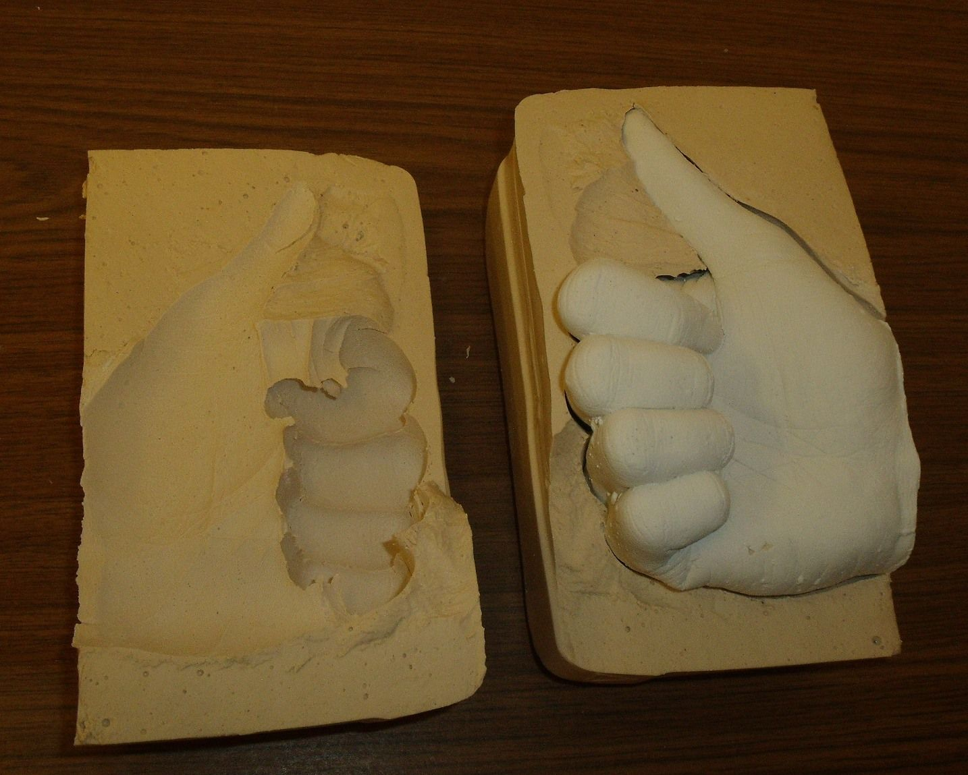
Classes vs Objects
A class can be compared to a plaster.
An object be compared to a cast.
Casts can be made with plasters.
Example: A cast of a Hand is made out of a plaster of the Hand.
Cast of a Hand = Object
Plaster of the Hand = Class
Each object is different with its own characteristics (attributes) and behaviour (mehods).
Source picture: https://i.pinimg.com/originals/be/30/c9/be30c9788460cad517028306f4259cb4.jpg

Slide 22
Object Oriented Programming
Class
Objects

Slide 23
Object Oriented Programming
Class
Objects
Person
name
residence
attributes
tell()
move()
methods

Slide 24
Object Oriented Programming
Class
instantiation
Objects
Person
name
residence
attributes
tell()
move()
methods
name: Peter
residence: Utrecht
name: Janneke
residence: Amsterdam
instances
naam: Kim
residence: Delft

Slide 25
Object Oriented Programming
Class
instantiation
Objects
Person
I am Peter and I live in Urecht
name
residence
attributes
I am Janneke and I live in Amsterdam
tell()
move()
methods
name: Peter
residence: Utrecht
I am Kim and i live in Delft
name: Janneke
residence: Amsterdam
tell()
instances
name: Kim
residence: Delft

Slide 26
Object Oriented Programming
Class
instantiation
Objects
str
'something'
attributes
'something else'
upper()
lower()
split()
strip()
join()
title()
capitalize()
replace()
methods
'hello world'
upper()
instances

Slide 27
Object Oriented Programming
Class
instantiation
Objects
list
[1, 2, 3]
attributes
['something', 'something else']
append()
insert()
extend()
pop()
sort()
methods
sort()
instances

Slide 28
Turtle
Exercise 1.5 or demonstration by the trainer
Draw a polygon with turtle.
Check out the different methods that you can use with turtle
in particular: forward and left
Import turtle
End the program with turtle.done()
Draw a square
Draw a polygon
Calculate the angle of each corner https://nl.wikipedia.org/wiki/Regelmatige_veelhoek

Slide 29
Classes
First define a class with the keyword class
Instantiate an object with the class
Set the state of the object by assigning values to the attributes
Call the methods of the object
Use the object operator . (a dot) to access attributes and methods
class Person:
pass
# --------------------------------
p = Person()
p.name = 'Albert'
p.residence = 'Amsterdam'

Slide 30
Methods
Methods are just like functions with in a class. Methodes can have arguments and a return statement just like normal functions.
The first argument is automatically set to the 'target' object. This is typically called self.
Also access methods met the object operator .
class Person:
def tell(self):
return f'I am f{self.name}'
# ------------------------------------------------------------
p = Person()
p.name = 'Albert'
print( p.tell() )

Slide 31
Object initialisation
When an object in created (instantiated) from a class de __init__ method is automatically called
__init__ is called a magic method. Where are many magic methods.
class Person:
def __init__(self, name):
self.name = name
def tell(self):
return(f'I am {self.name}')
# ------------------------------------------------------------
p = Person('Albert')
print( p.tell() )

Slide 32
Attributes
Attributes are typically initialized in the __init__ method.
Attributes are dynamic and can be assigned a value anywhere.
class Person:
def __init__(self, name, residence = 'unknown'):
self.__name = name
self.__residence = residence
def tell(self):
return(f'I am {self.__name} from {self.__residence}')
# ------------------------------------------------------------
p = Person('Albert', 'Amsterdam')
print( p.tell() )

Slide 33
Public or not
An attribute can be indicated as non-public by adding _ as a prefix to the name of the attribute.
This is more of a a guideline "We are all adults and know what we're doing."
You can add a double underscore __ to obstify the name of the attribute outside of the class. This is to prevent naming collissons when inheriting classes.
class Person:
def __init__(self, name):
self._name = name
def tell(self):
return(f'I am {self._name}')
# ------------------------------------------------------------
p = Person('Albert')
print( p.tell() )

Slide 34
Object attributes vs Class-wide attributes
Most attributes are attributes related to objects.
This means that an object has to be made first, before you can use or access that attribute.
It can only work for that specific object.
But sometimes there are attributes that you want to use from the class itself.
These are called: Class-wide attributes
Notes:
Decorators

Slide 35
Class-wide attributes
Class wide attributes are attributes that are related to the class instead of to an object of that class.
Class wide attributes can be accessed by all objects of the class
class Mathematics:
pi = 3.14159
e = 2.71828
print( Mathematics.pi )
print( Mathematics.e )

Slide 36
Object methods vs Class-wide methods
Most methods are methods related to objects.
This means that an object has to be made first, before you can use that method.
It can only work for that specific object.
But sometimes there are methods that you want to use from the class itself.
These are called: Class-wide methods
Notes:
Decorators

Slide 37
Class-wide methods
Most methods are methods related to objects, but:
Class-wide methods are methods related to the class.
A method can be indicated as a class-wide methode with a decorator @classmethod or @staticmethod.
class Mathematics:
@staticmethod
def power1(x, n):
result = 1
for __ in range(n):
result *= x
return result
@classmethod
def power2(cls, x, n):
return cls.power1(x, n)
print(Mathematics.power1(2, 4))
print(Mathematics.power2(2, 4))
Notes:
Decorators

Slide 38
Example
class Person:
__slots__ = ('__name', '__residence')
def __init__(self, name, residence = 'unknown'):
self.__name = name
self.__residence = residence
def tell(self):
return('I am {} and I live in {}'\
.format(self.__name, self.__residence))
def move(self, new_residence):
self.__residence = new_residence
p = Person('Albert', 'Amsterdam')
print( p.tell() )
p.move('Eindhoven')
print( p.tell() )

Slide 39
Bankaccount
Exercise 1.6
Create a Bankaccount class, create serveral Bankaccount objects and demonstrate that you can deposit and withdraw amount to the account.
Tips:
Create a class Bankaccount
Add attributes in the __init__ method. Attributes should be __balance and __holder.
Add the methods: deposit and withdraw that take an amount argument and a third method info that returns information about the account.
Instantiate serveral bankaccount objects and demonstrate the working of the class

Slide 40
Class Car
Exercise 1.7
Create a class named Car
Add the __init__ method and set several attributes like _make, _type and _color
Set the _mileage attribute to 0
Create a method info that describes the car and the mileage
Create a method drive that takes an amount of kilometers and adds that to the mileage.
Test you class by instantiating a car and calling the methods
EXTRA: Voeg een Execption toe als er een negatieve drive wordt gegeven Je kan immers nooit negatieve kilometers rijden.

Slide 41
Special Methods
A class can have many different special methods.
Also called magic methods.
A magic method is called by Python in all kind of situations, typically when operators are used
__init__
__del__
__str__
__repr__
__eq__
__ne__
__lt__
__le__
__gt__
__ge__
__add__
__sub__

Slide 42
Vector class
Exercise 1.8
Create a 2d-Vector class. Also add operator overloading for the + sign to add two vectors together.
Tips:
Build a class called Vector
Add two attributes: x and y
Implement the __init__ method that takes two arguments: x and y
Implement the __str__ and __repr__ methods.
Implement the __add__ method the define the adding of two vectors.
Test your class by creating two vectors and adding these together.

Slide 43
Inheritance
Classes can be reused by inheritance
The original class is called the parent class, the superclass or the base class
The new class is called the child class, the subclass or the derived class
Enclose the parent in parentheses after the new class name.
All the attributes and methods of the parent class are avaiable in the child class.
In the __init__ method of the child class always first call de __init__ method of the parent class with the super method
class Vector(object):
class ChildClass(ParentClass):
def __init__(self, name):
super().__init__(name)

Slide 44
Democodes
There are more examples of democode for OO programming in Python
Animal.py
Auto.py
DemoOO.py
Dier.py
Person.py
Person2.py

Slide 45
Make your own classes
Exercise 1.9
Create your own classes for your own work.
First, think about the classes you need for your work
Make UML class diagram.
Ask the trainer if everything is correct in UML what you are thinking about to make.
If the trainer gives you a GO, you can begin programming in Python.

Slide 46
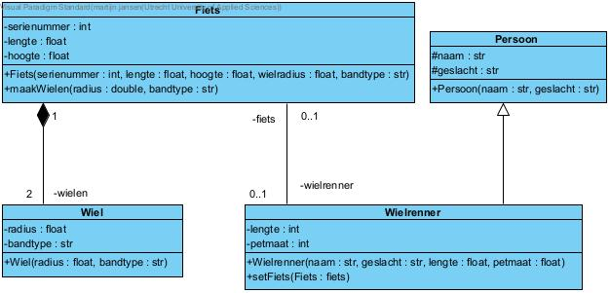
Make your own classes
Exercise 1.9
Example for the trainer:
Forward engineering Python file: Fiets.py
Notes:
De trainer kan dit voorbeeld gebruiken om uit te werken in code. Hierin komt van alles terug:
Klassen
Overerving
Associaties met andere klassen.
Met behulp van dit voorbeeld wordt alles geoefend.

Slide 47
Presentations of classes
Exercise 1.9: Results
Each group has made their own classes in Python according a class diagram.
Each group has to present their work to each others.
The trainer gives feedback during and after the presentations.
Presentations are given afternoon of next day

Slide 48
Python Standard Library
The Python Standard Library consists of more than 200 modules and packages
The Python has "batteries included"
os
os.path
sys
string
re
math
random
datetime
calendar
csv
collections
array
decimal
fractions
statistics
pathlib
pickle
shelve
json
xml
sqlite3
zipfile
time
argparse
logging
threading
multiprocessing
subprocess
socket
asyncio
urllib
http
tkinter
doctest
unittest
timeit

Slide 49
sys - System-specific
System-specific parameters and functions
version
version_info
path
argv
exit
stdin / stdout / stderr
import sys
# get Python version
print(sys.version)
# add directory to sys.path
sys.path.append(r'c:\pythondev')

Slide 50
os - Operating system interfaces
The os.path module provides a portable way of using operating system dependent functionality.
rename
remove
mkdir
makedirs
chdir
getcwd
rmdir
listdir
path
pipe
scandir
walk
fork
exec
system
getenv
getpid
getppid
kill
wait
nice
import os
# set current working directory
os.chdir(r'c:\pythondev')
print(os.getcwd())

Slide 51
pathlib - Object-oriented filesystem paths
This module offers classes representing filesystem paths with semantics appropriate for different operating systems.
Path
PurePath
WindowsPath
PureWindowsPath
operator /
parts
drive
root
anchor
parent
parents
cwd()
home()
chmod()
exists()
is_dir()
is_file()
glob()
from pathlib import Path
p = Path('.')
list(p.glob('**/*.py'))

Slide 52
shutil
High-level file operations
copy
copytree
rmtree
move
disk_usage
chown

Slide 53
glob
The glob module finds all the pathnames matching a specified pattern according to the rules used by the Unix shell.
import glob
glob.glob('./file[0-9].*')

Slide 54
subprocess
The subprocess module allows you to spawn new processes, connect to their input/output/error pipes, and obtain their return codes.
run
import subprocess
subprocess.run(["ls", "-l"])
subprocess.run(["ls", "-l", "/dev/null"], capture_output=True)

Slide 55
tempfile
This module generates temporary files and directories.
It works on all supported platforms.
TemporaryFile
NamedTemporaryFile
TemporaryDirectory
import tempfile
with tempfile.TemporaryFile() as fp:
fp.write(b'Hello world!')
fp.seek(0)
fp.read()

Slide 56
Democodes
DemoDatetime.py
DemoGlob.py
DemoPathlib.py
DemoSubprocess.py
DemoSys.py

Slide 57
datetime - Basic date and time types
The datetime module supplies classes for manipulating dates and times.
class datetime.date
class datetime.time
class datetime.datetime
class datetime.timedelta
class datetime.tzinfo
class datetime.timezone
strftime
strptime
from datetime import date
d = date(2020, 2, 28)
print(d.strftime('%Y-%m-%d'))

Slide 58
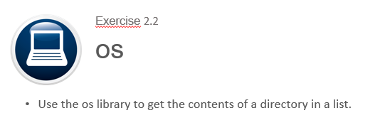
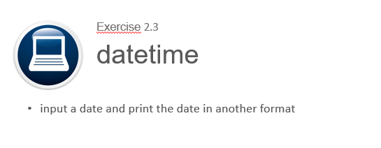
sys
Exercise 2.1
Get the current version of Python
Return the message you are currently running Python version …

Slide 59
os
Exercise 2.2
Use the os library to get the contents of a directory in a list.

Slide 60
datetime
Exercise 2.3
input a date and print the date in another format

Slide 61
string - Common string operations
String methods
count
find
format
index
isnumeric
join
lower
replace
split
strip
title
# remove vowels
s = 'an example text'
vowels = "aeiou"
trans = str.maketrans("", "", vowels)
result = s.translate(trans)

Slide 62
re - Regular expression operations
Online: https://www.regex101.com/#python
search(pattern, string, flags)
match(pattern, string, flags)
findall(pattern, string, flags)
sub(pattern, repl, string, max=0, flags)
compile(pattern)
import re
match = re.search(r'@([\w\.]+)\b', 'albert@gmail.com', re.I)
if match:
for group in match.groups():
print('Domain: ', group)

Slide 63
math - Mathematical functions
pi
e
acos
acosh
asin
asinh
atan
atan2
atanh
ceil
copysign
cos
cosh
degrees
erf
erfc
exp
expm1
fabs
factorial
floor
fmod
frexp
fsum
gamma
gcd
hypot
inf
isclose
isfinite
isinf
isnan
ldexp
lgamma
log
log10
log1p
log2
modf
nan
pow
radians
remainder
sin
sinh
sqrt
tan
tanh
tau
trunc

Slide 64
random - Pseudo-random numbers
Generate pseudo-random numbers
random.seed()
random.randrange(start, stop)
random.randint(a, b)
random.choice(sequence)
random.choices(sequence, k=1)
random.shuffle(sequence)
random.sample(sequence, n)
random.random()
import random
items = 'abcdefghiklmnopqrstuwvxyz0123456789'
sample = random.sample(items, 3)

Slide 65
json - JavaScript Object Notation
json.dump(object, file)
json.dumps(object)
json.load(file)
json.loads(string)
JSON encoder and decoder
import json
s = json.dumps([1,2,3,{'4': 5, '6': 7}])
with open('bestand.json', 'w') as f:
json.dump([1,2,3,{'4': 5, '6': 7}], f)
json.loads('[1,2,3,{"4":5,"6":7}]')

Slide 66
pickle - Python object serialization
A shelf is a persistent, dictionary-like object that stores any arbitrary Python that can be pickled.
pickle.dump(object, file)
pickle.dumps(object)
pickle.load(file)
pickle.loads(string)
import pickle
class User: def saveToPickle(self):
with open('user.pickle','wb') as f:
pickle.dump(self, f)
def loadFromPickle(self):
with open('user.pickle','rb') as f:
self.__dict__.update(pickle.load(f).__dict__)
@classmethod
def createFromPickle(cls):
with open('user.pickle','rb') as f:
return pickle.load(f)

Slide 67
xml
The xml.etree.ElementTree module implements a simple and efficient API for parsing and creating XML data.
This module provides limited support for XPath expressions for locating elements in a tree. https://www.w3schools.com/xml/xpath_intro.asp
ElementTree provides a simple way to build XML documents and write them to files.
import xml.etree.ElementTree as ET
tree = ET.parse('data.xml')
root = tree.getroot()
print(root.attrib)
for element in root.findall('//name'):
print(element.text)

Slide 68
statistics
This module provides functions for calculating mathematical statistics of numeric (Real-valued) data.
bisect_left
bisect_right
collections
groupby
harmonic_mean
mean
median
median_grouped
median_high
median_low
mode
numbers
pstdev
pvariance
stdev
variance
statistics
import statistics numbers = [23, 64, 86, 23, 54, 76, 98, 21]
print('Median:', statistics.median(numbers))
print('Mean:', statistics.mean(numbers))
print('St.Dev.:', statistics.stdev(numbers))

Slide 69
doctest
The doctest module searches for pieces of text that look like interactive Python sessions, and then executes those sessions to verify that they work exactly as shown.
def square(n):
"""Calculate the square of n.
>>> [square(n) for n in range(6)]
[0, 1, 4, 9, 16, 25]
"""
return n ** 2
if __name__ == "__main__":
import doctest
doctest.testmod(verbose=True)

Slide 70
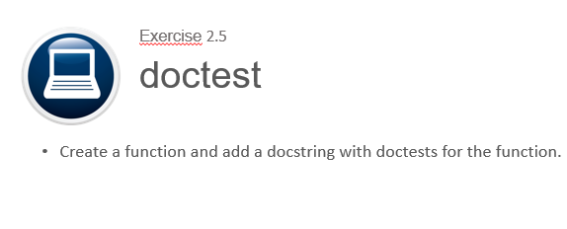
Pickle vs json
Exercise 2.4
Create a datastructure and store this in a pickle file. Create a second python script that reads pickle file and restores the data in the data structure.
Do the same only now with a json
Compare the pickle and json files

Slide 71
doctest
Exercise 2.5
Create a function and add a docstring with doctests for the function.

Slide 72
Statistics
Exercise 2.6
Create a function that calculates and returns the mean, median and mode of a list of numbers.
Tips:
Define a function as def central_measures(numbers)
Calculate the measures:
The mean is the sum of the values divided by the number of values
The median is middle value of the sorted list of values
The mode is the most frequently occuring value
Return the measures as a tuple with return mean, median, mode
Call the function with a list of arbitrary numbers
Print the result

Slide 73
unittest - Unit testing framework
assertEqual(a, b)
assertNotEqual(a, b)
assertTrue(x)
assertFalse(x)
assertIs(a, b)
assertIsNot(a, b)
assertIsNone(x)
assertIsNotNone(x)
assertIn(a, b)
assertNotIn(a, b)
assertIsInstance(a, b)
assertNotIsInstance(a, b)
There is also an assert statement
import unittest
class TestStringMethods(unittest.TestCase):
def test_upper(self):
self.assertEqual('foo'.upper(), 'FOO')
def test_isupper(self):
self.assertTrue('FOO'.isupper())
self.assertFalse('Foo'.isupper())
if __name__ == '__main__':
unittest.main()

Slide 74
csv – Comma Seperated Values
CSV File Reading and Writing
reader
writer
DictReader
DictWriter
import csv
filename = 'data.csv'
with open(filename) as f:
reader = csv.DictReader(f, delimiter=';')
for row in reader:
print(row['first_name'], row['last_name'])

Slide 75
decimal
The decimal module provides support for fast correctly-rounded decimal floating point arithmetic.
from decimal import Decimal
d1 = Decimal('0.1')
d2 = Decimal('0.2')
result = float(d1 + d2)

Slide 76
fractions
The fractions module provides support for rational number arithmetic.
from fractions import Fraction
d1 = Fraction(1, 3) # => 1/3
d2 = Fraction(1, 2) # => 1/2
result = d1 + d2 # => 5/6

Slide 77
sqlite3
DB-API 2.0 interface for SQLite databases
PEP 249 - Database API Specification 2.0
import sqlite3
conn = sqlite3.connect('example.db')
c = conn.cursor()
c.execute("""CREATE TABLE stocks
(date text, trans text, symbol text, qty real, price real)""")
c.execute("""INSERT INTO stocks
VALUES ('2006-01-05’, 'BUY’, 'RHAT’, 100, 35.14)""")
conn.commit()
for row in c.execute('SELECT * FROM stocks ORDER BY price'):
print(row)
conn.close()

Slide 78
Concurrency
concurrency
multiprocessing
threading
asynchronous IO
Python Standard Library:
multiprocessing package
threading package
asyncio package and async/await keywords (introduced in Python 3.4)

Slide 79
Comparison
 | Multiprocessing | Threading | Asynchronous IO
Package | multiprocessing | threading | asyncio
Class | Proces | Thread | Coroutine
Python | Class Proces | Class Thread | Keywords async, await
Data sharing | Message | Shared data
Usage | CPU intensive | IO intensive | IO intensive

Slide 80
Proces versus Thread
True parallelism in Python is achieved by creating multiple processes, each having a Python interpreter with its own separate GIL.
Process | Thread
processes run in separate memory (process isolation) | threads share memory
uses more memory | uses less memory
children can become zombies | no zombies possible
more overhead | less overhead
slower to create and destroy | faster to create and destroy
easier to code and debug | can become harder to code and debug

Slide 81
Python GIL
A global interpreter lock (GIL) is a mechanism used in Python interpreter to synchronize the execution of threads so that only one native thread can execute at a time, even if run on a multi-core processor.
The C extensions, such as numpy, can manually release the GIL to speed up computations. Also, the GIL released before potentionally blocking I/O operations.
Note that both Jython and IronPython do not have the GIL.

Slide 82
threading - Thread-based parallelism
Thread
start
run
join
name
active_count
current_thread
main_thread
import time
from threading import Thread
def myfunc(i):
print "sleeping 5 sec from thread %d" % i
time.sleep(5)
print "finished sleeping from thread %d" % i
for i in range(10):
t = Thread(target=myfunc, args=(i,))
t.start()

Slide 83
asyncio
At the heart of async IO are coroutines. A coroutine is a specialized version of a Python generator function.
import asyncio
async def count():
print("One")
await asyncio.sleep(1)
print("Two")
async def main():
await asyncio.gather(count(), count(), count())
if __name__ == "__main__":
import time
s = time.perf_counter()
asyncio.run(main())
elapsed = time.perf_counter() - s
print(f"{__file__} executed in {elapsed:0.2f} seconds.")

Slide 84
multiprocessing
The multiprocessing library is based on spawning Processes.
A process starts a fresh Python interpreter thereby side-stepping the Global Interpreter Lock
The multiprocessing module allows the programmer to fully leverage multiple processors on a given machine.
from multiprocessing import Process def f(name): print('hello', name) if __name__ == '__main__': p = Process(target=f, args=('bob',)) p.start() p.join()

Slide 85
logging - Logging facility for Python
Setup with basicConfig
Logging Levels: DEBUG, INFO, WARNING, ERROR, CRITICAL
import logging
logging.basicConfig(
filename = None, # or to a file 'example.log',
level = logging.ERROR,
format = '%(asctime)s.%(msecs)03d - %(message)s',
datefmt = '%Y-%m-%dT%H:%M:%S')
logging.debug('This message should go to the log file')
logging.info('So should this')
logging.warning('And this, too') logging.error('Watch out!') logging.critical('ERROR!!!!!')

Slide 86
timeit
Measure execution time of small code snippets.
from timeit import timeit
timeit('"-".join(str(n) for n in range(100))', number=10000)
timeit(lambda: "-".join(map(str, range(100))), number=10000)

Slide 87
zipfile
The ZIP file format is a common archive and compression standard. This module provides tools to create, read, write, append, and list a ZIP file.
import zipfile
import pandas as pd
with zipfile.ZipFile("FinalExam.zip") as z:
with z.open("AdvWorksCusts.csv") as f:
df_Customers = pd.read_csv(f)
with z.open("AW_AveMonthSpend.csv") as f:
df_AveMonthSpend = pd.read_csv(f)
with z.open("AW_BikeBuyer.csv") as f:
df_BikeBuyer = pd.read_csv(f)

Slide 88
tarfile
The tarfile module makes it possible to read and write tar archives, including those using gzip, bz2 and lzma compression.
import tarfile
t = tarfile.open('example.tar.gz', 'r')
print("Files in TAR file:")
print(t.getnames())

Slide 89
Democodes
DemoAsyncio.py
DemoDocstring.py
DemoDocstringPPT.py
DemoSubprocess.py
DemoThreading.py

Slide 90
GUI Frameworks
TkInter - The traditional Python user interface toolkit.
PyQt - Bindings for the cross-platform Qt framework.
PySide - PySide is a newer binding to the Qt toolkit
wxPython - a cross-platform GUI toolkit that is built around wxWidgets
Win32Api - native window dialogs
PyMsgBox

Slide 91
tkinter
The tkinter package (“Tk interface”) is the standard Python interface to the Tk GUI toolkit.
There are also Standard Dialogs
import tkinter as tk
import tkMessageBox
top = tk.Tk()
def hello():
tkMessageBox.showinfo("Say Hello", "Hello World")
btn1 = tk.Button(top, text = "Say Hello", command = hello)
btn1.pack()
top.mainloop()

Slide 92
The Python Package Index - PyPI
The official third-party software repository for the Python programming language
The Python Package Index is a repository of software for the Python programming language. There are currently > 300000 packages.
Install packages with the pip command.
pip list
pip search
pip install numpy
pip install scipy
pip install matplotlib
pip install pandas
pip install requests
pip install pyodbc

Slide 93
pyodbc - Accessing ODBC databases
import pyodbc
conn = pyodbc.connect(
'DRIVER={SQL Server};'
'SERVER=localhost\SQLEXPRESS;'
'DATABASE=mijndatabase;'
'UID=username; PWD=pa55w0rd')
sql = 'SELECT customers.* FROM customers'
cursor = conn.cursor()
for row in cursor.execute(sql):
print("{}, {}".format(row.name, row.residence)
cursor.close()
conn.close()
PEP 249 -- Python Database API Specification v2.0

Slide 94
requests – HTTP for Humans
Requests is an elegant and simple HTTP library for Python, built for human beings.
import requests
url = "http://api.openweathermap.org/data/2.5/weather"
url += "?appid=d1526a9039658a6f76950cff21823aff"
url += "&units=metric"
url += "&mode=json"
url += "&q=New York"
response = requests.get(url)
if (response.status_code == 200):
body = response.text
decoded = response.json() temperature = decoded['main']['temp']
else:
print("Error for city %s" % (city))

Slide 95
Get the weather in New York
Exercise 2.7
Use requests to query openweathermap.org for the weather in a specified city.
Tips:
import requests
build the url (see https://openweathermap.org/current) use: appid=d1526a9039658a6f76950cff21823aff
use the following code to get the response: response = requests.get(url)
use json to decode the response into a Python dictionary
response.json()
get and print the temperature

Slide 96
The Python Package Index - PyPI
Go to the website: https://pypi.org/
The trainer will give a demonstration how to install a Python Package Index.
One of the following examples can be used:
Open Weather Map
Requests
HTML Converter / Generator
PDF Converter / Generator
Excel Converter to …
Can you give more examples for demonstration?

Slide 97
Python for Data Science
Python is used very much in Data Science.
Therefore, Aanconda has been made. Anaconda is a big program / Python version with all the data science libraries already in it.
So, you don’t have to install all the data science libraries from the Python Package Index.
https://pandas.pydata.org/docs/getting_started/10min.html#min

Slide 98
numpy
NumPy is the fundamental package for scientific computing with Python.
NumPy's main object is the homogeneous multidimensional array.
Vectorized operations
import numpy as np
a = np.array([1,2,3,4])
b = np.array( [ (1.5,2,3), (4,5,6) ] )
c = np.narray( [ [1,2], [3,4] ], dtype=complex )
np.zeros( (3,4) )
np.arange( 0, 2, 0.4 ) # array([ 0., 0.4, 0.8, 1.2, 1.6, 2.0])
np.linspace( 0, 2*pi, 100 ). # 100 numbers from 0 to 2*pi

Slide 99
scipy
Clustering
Constants
Discrete Fourier transforms
Integration
Interpolation
Input and output
Linear algebra
Miscellaneous routines
Multi-dimensional image processing
Orthogonal distance regression
Optimization and Root Finding
Signal processing
Sparse matrices
Sparse linear algebra
Compressed Sparse Graph Routines
Spatial algorithms and data structures
Special functions
Statistical functions
Statistical functions for masked arrays
Low-level callback functions
It provides many user-friendly and efficient numerical routines, such as routines for numerical integration, interpolation, optimization, linear algebra, and statistics.

Slide 100
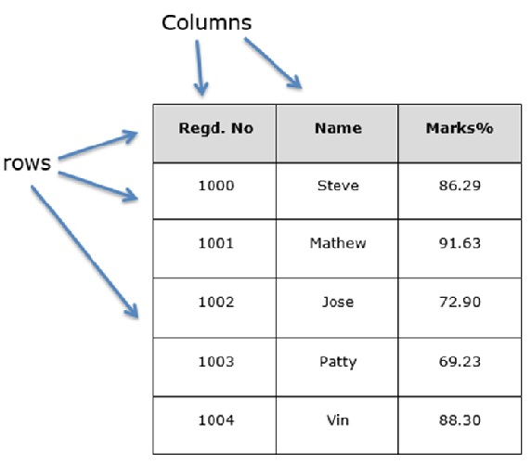
pandas
Pandas is a fast, powerful, flexible and easy to use open source data analysis and manipulation tool.
Series is a one-dimensional labeled array capable of holding any data type
DataFrame is a 2-dimensional labeled data structure with columns of potentially different types.
https://pandas.pydata.org/docs/getting_started/10min.html#min

Slide 101
matplotlib
Matplotlib is a Python 2D plotting library which produces publication quality figures
Line plot
Histogram
Scatter plot
3D plot
Image plot
Contour plot
Polar plot
import matplotlib.pyplot as plt
import numpy as np
x = np.linspace( 0.000001, 2*np.pi, 100 )
y = 1/x * np.sin(5*x)
plt.plot(x, y)
plt.show()

Slide 102
Python for Data Science
If you want to learn more about this, subscribe to the course:
Python voor Data Science
At Computrain!
https://pandas.pydata.org/docs/getting_started/10min.html#min

Slide 103
django
MVC Framework
Models
Object-Relational Mapping
URL Mapping
Views
HTML Templates
Command line bootstrap:
$ mkdir django-demo
$ cd django-demo
$ virtualenv -p python3.5 venv
$ . venv/bin/activate
$ pip install django
$ django-admin
$ django-admin startproject demo
$ python manage.py createsuperuser
$ python manage.py startapp books
$ python manage.py makemigrations
$ python manage.py migrate
$ python manage.py runserver

Slide 104
Python Distributions
Anaconda
Active Python
Python (X,Y)
IPython
Enthought Canopy
Sage
PyPy
Pocket Python
Portable Python

Slide 105
Implementations
CPython reference implementation
IronPython (Python running on .NET)
Jython (Python running on the Java Virtual Machine)
PyPy (A fast python implementation with a JIT compiler)
Stackless Python (Branch of CPython supporting microthreads)
MicroPython (Python running on micro controllers)

Slide 106
Style Guide for Python Code
PEP 8 - Style Guide for Python Code
Notes:
Python Enhancement Proposals (PEPs)

Slide 107
Virtual Environment
Seperated enviroments
Requirements file
$ virtualenv –p python3.5 venv
$ . venv/bin/activate
$ pip list > requirements.txt
$ pip install -r requirements.txt

Slide 108
Ducktyping
“If it looks like a duck and quacks like a duck, it must be a duck.”
A programming style which does not look at an object’s type to determine if it has the right interface; instead, the method or attribute is simply called or used

Slide 109
EAFP versus LBYL
EAFP: "it's easier to ask for forgiveness than permission
LBYL: "look before you leap"

Slide 110
Python Advanced
Thank you for your attention!
Goodbye!

